Slide 1
2D Array
Python Class #7
HEHology

Slide 2
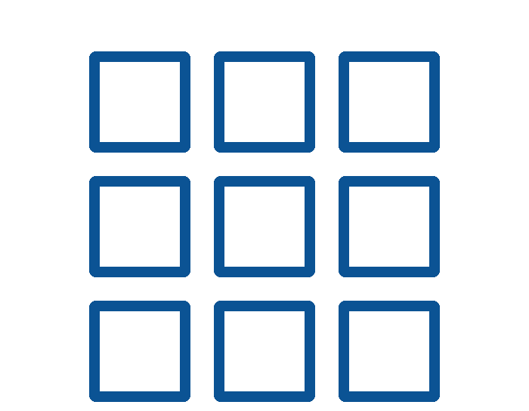
2D Array
What is that?
Length and Width
What’s the point of 2D array?
2D
‹#›
HEHology

Slide 3

NumPy
What is NumPy?
Library for arrays
What are NumPy types?
Anything numeral
Why use NumPy?
Efficient
‹#›
HEHology

Slide 4
Installing NumPy
Terminal
pip help
python get-pip.py
pip install numpy
‹#›
HEHology

Slide 5
Defining NumPy Array
import numpy as np
matrix = numpy.zeros((5, 5))
import numpy as np
matrix = numpy.ones((3, 3))
import numpy as np
matrix = np.array([[1, 2],
[3, 4]])
‹#›
HEHology

Slide 6
CRU
HEHology

Slide 7

C is for Create
copy()
Copies values
Does not copy identity
Does not change one change both
matrix = np.array([[1, 2],
[3, 4]])
map = matrix.copy()
view()
Copies values
Does not copy identity
Change one change both
matrix = np.array([[1, 2],
[3, 4]])
map = matrix.view()
‹#›
HEHology

Slide 8

R is for Read
map[0][0] or map[0,0]
Get value from 2d array
var = matrix[1][0]
ndim
Get number of dimensions
print(map.ndim)
dtype
Gets data type
print(matrix.dtype)
base
Gets the array that owns it
print(map.base)
shape
Gets the shape of array
print(arr.shape)
‹#›
HEHology

Slide 9

U is for Update
arr[0][0] = 100
sort
Sorts each row in ascending order
print(np.sort(arr))
‹#›
HEHology

Slide 10
Iterating 2D Array
for x in matrix:
for y in x:
print(y, end=' ')
print()
‹#›
HEHology

Slide 11

Thanks!
Any questions?
HEHology

